Slide 1
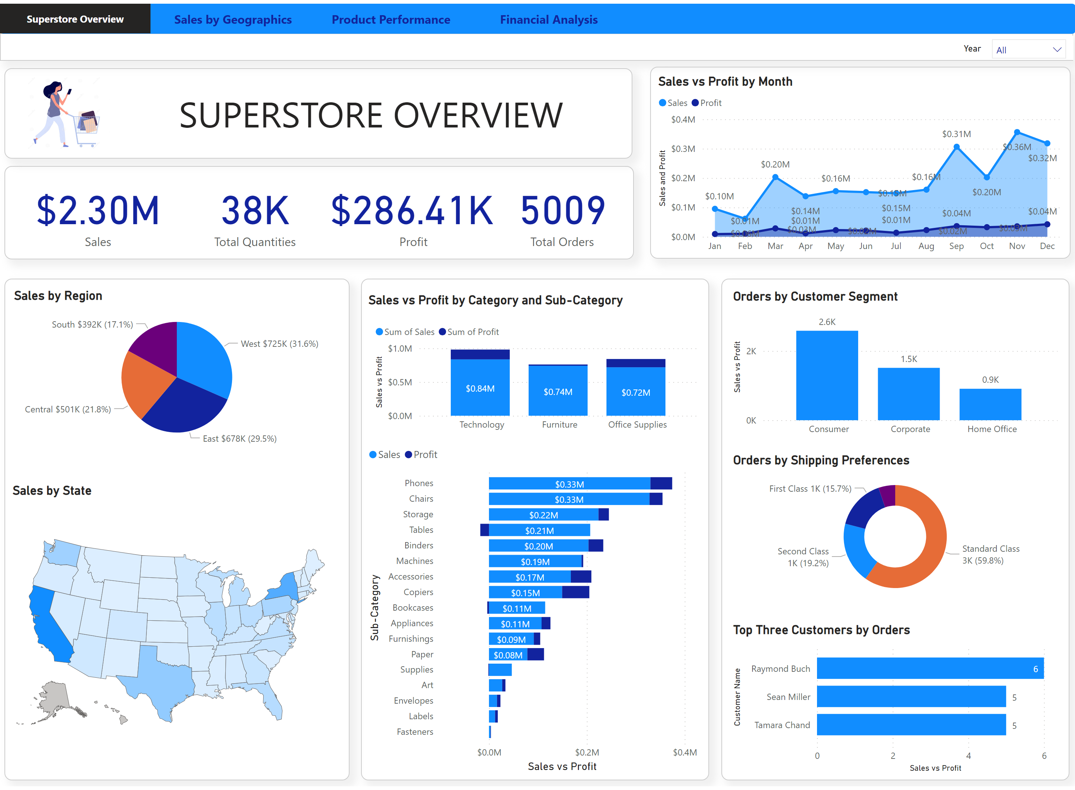
Superstore Overview
Notes:
Location Shape
No alt text provided
Sales by State
No alt text provided
Sales by Region
No alt text provided
Page navigator
No alt text provided
Page Shape
No alt text provided
textbox
No alt text provided
Category
No alt text provided
shape
No alt text provided
Orders by Customer Segment
No alt text provided
Top Three Customers by Orders
No alt text provided
Orders by Shipping Preferences
No alt text provided
Order Shape
No alt text provided
Category Shape
No alt text provided
Sales vs Profit by Category
No alt text provided
Text box
No alt text provided
Sales vs Profit by Sub-Category
No alt text provided
Matrix Shape
No alt text provided
card
No alt text provided
card
No alt text provided
card
No alt text provided
card
No alt text provided
Date Shape
No alt text provided
Sales vs Profit by Month
No alt text provided
image
No alt text provided
Title Shape
No alt text provided
textbox
No alt text provided

Slide 2
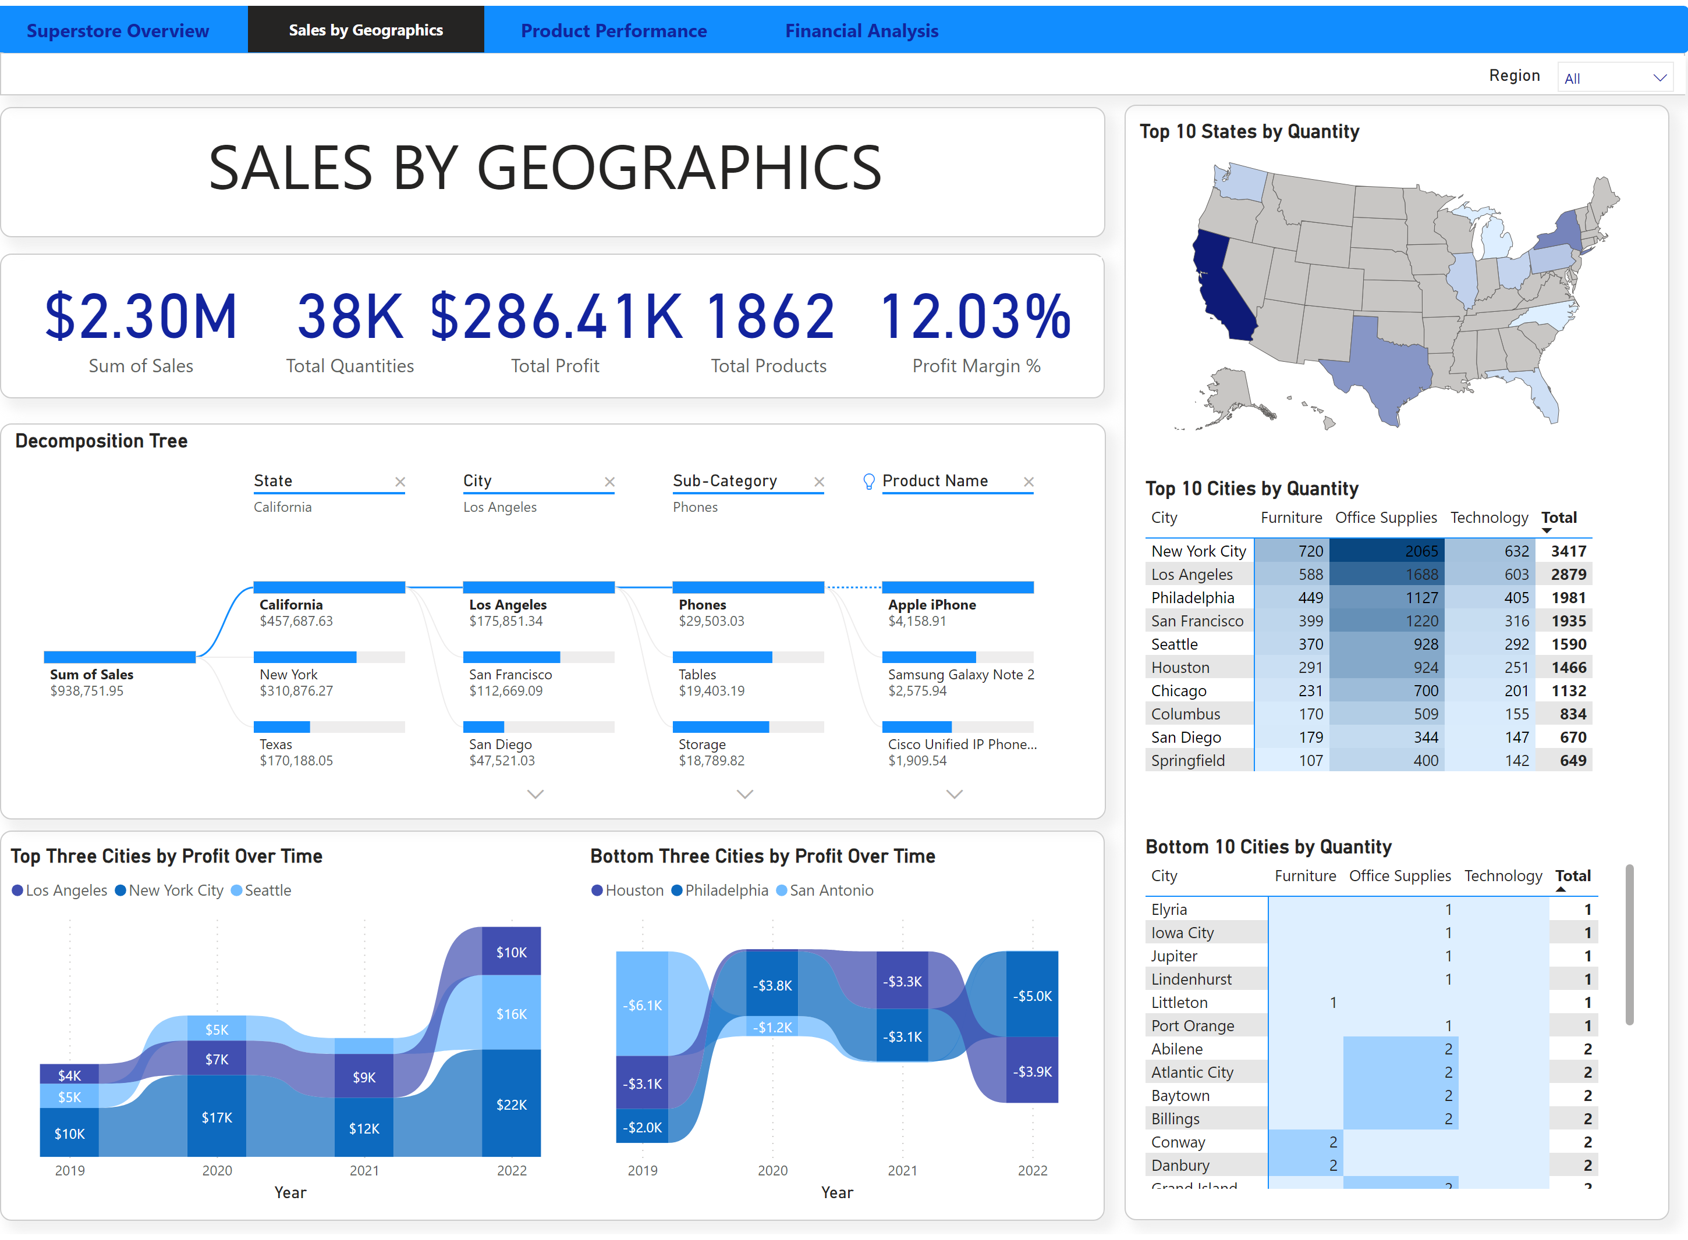
Sales by Geographics
Notes:
Title Shape
No alt text provided
textbox
No alt text provided
card
No alt text provided
card
No alt text provided
card
No alt text provided
card
No alt text provided
card
No alt text provided
Matrix Shape
No alt text provided
Top 10 States by Quantity
No alt text provided
Top 10 Cities by Quantity
No alt text provided
Bottom 10 Cities by Quantity
No alt text provided
Shape
No alt text provided
Shape
No alt text provided
Decomposition Tree
No alt text provided
Shape
No alt text provided
Bottom Three Cities by Profit Over Time
No alt text provided
Top Three Cities by Profit Over Time
No alt text provided
Page navigator
No alt text provided
Page Shape
No alt text provided
Text box
No alt text provided
Category
No alt text provided
shape
No alt text provided

Slide 3
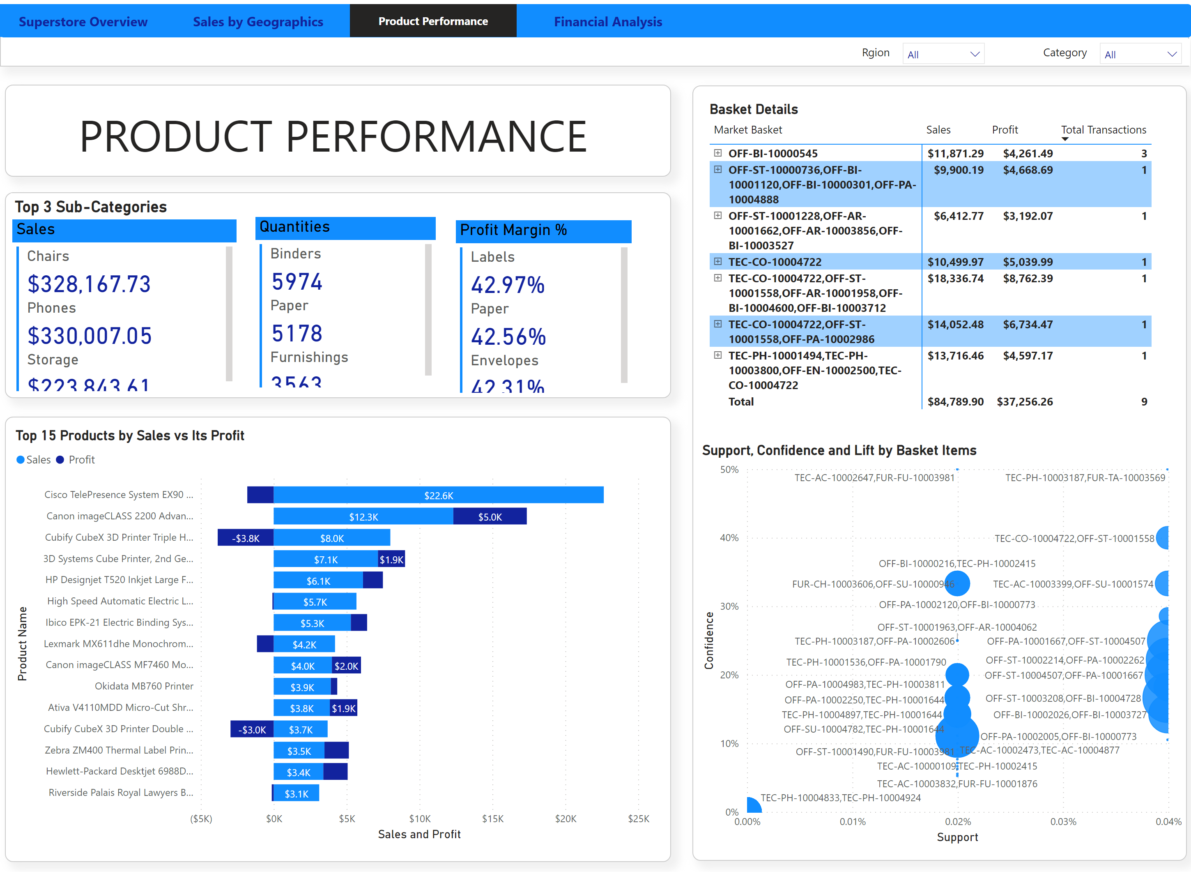
Product Performance
Notes:
Title Shape
No alt text provided
textbox
No alt text provided
Profit Margin %
No alt text provided
Shape
No alt text provided
Quantities
No alt text provided
Sales
No alt text provided
textbox
No alt text provided
Basket Details
No alt text provided
Shape
No alt text provided
Support, Confidence and Lift by Basket Items
No alt text provided
scatterChart
No alt text provided
Top 15 Products by Sales vs Its Profit
No alt text provided
Shape
No alt text provided
Page navigator
No alt text provided
Page Shape
No alt text provided
Category
No alt text provided
Text box
No alt text provided
Category
No alt text provided
Text box
No alt text provided
shape
No alt text provided
actionButton
No alt text provided

Slide 4
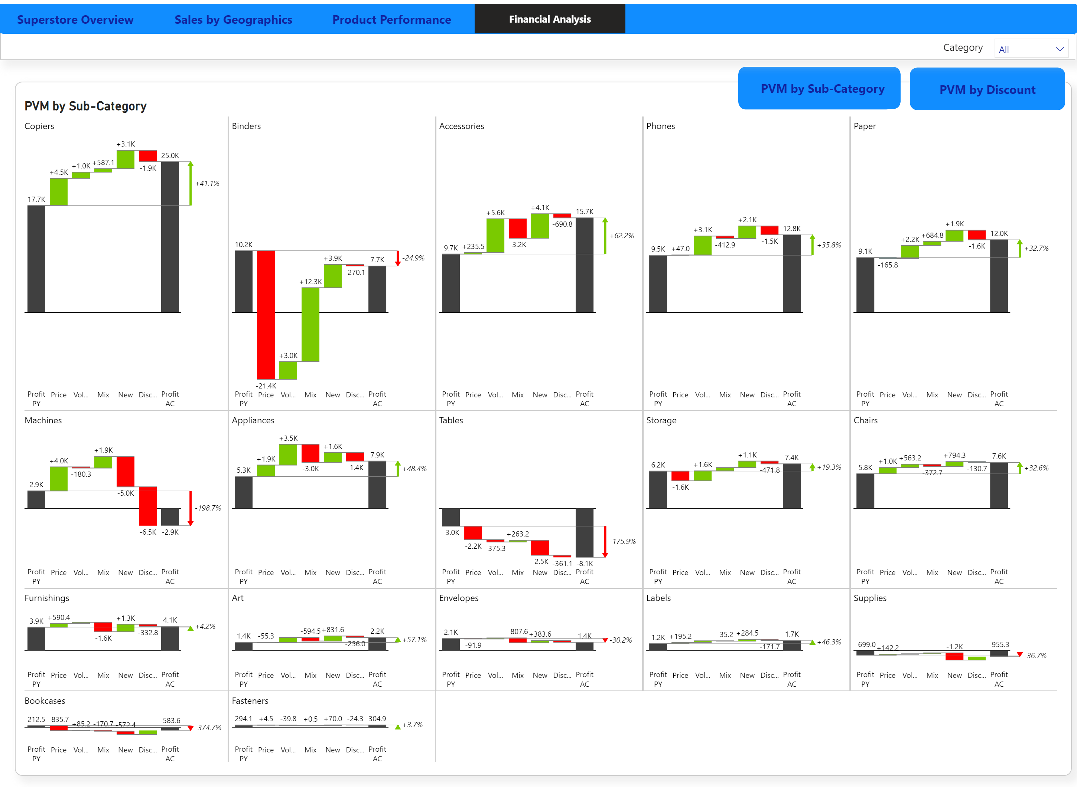
Financial Analysis
Notes:
PVM by Sub-Category
No alt text provided
PVM by discount
No alt text provided
PVM by Sub-Category
No alt text provided
Shape
No alt text provided
ZebraBITablesBAE31B370F254F808553548EFB35BFA5
No alt text provided
PVM by Sub-Category
No alt text provided
actionButton
No alt text provided
shape
No alt text provided
textbox
No alt text provided
Page navigator
No alt text provided
Page Shape
No alt text provided
Category
No alt text provided
Text box
No alt text provided
shape
No alt text provided

Slide 5
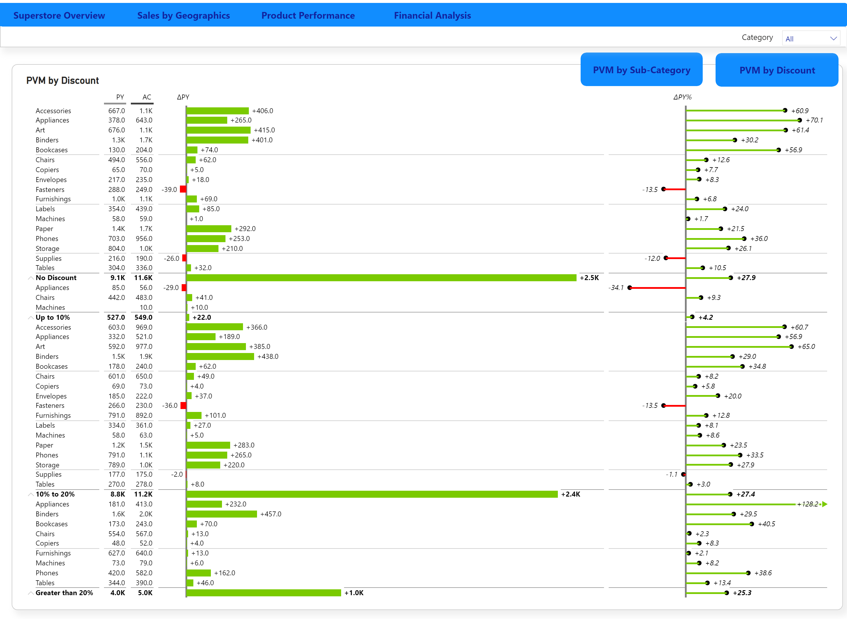
Financial Analysis2
Notes:
PVM by Sub-Category
No alt text provided
PVM by discount
No alt text provided
waterfall6C9ED82ABD1F44C4A0D590CE01EB5EE7
No alt text provided
Shape
No alt text provided
PVM by Discount
No alt text provided
actionButton
No alt text provided
PVM by discount
No alt text provided
shape
No alt text provided
textbox
No alt text provided
Page navigator
No alt text provided
Page Shape
No alt text provided
Category
No alt text provided
Text box
No alt text provided
shape
No alt text provided

